Slide 1

[Samsung PRISM] Preliminary Discussion
Develop a Quality Assurance framework for Image Generation Models
Team
College Professor(s): Dr. Antony Louis Piriyakumar, Prof Geetha R
Students:
Ayush Kumar Singh / ayushkumar.20aiml@cambridge.edu.in
Akash V / akash.20aiml@cambridge.edu.in
Girish Chandra Saxena / chandrasaxena.20aiml@cambridge.edu.in
P Aaditya / padditiya.20aiml@cambridge.edu.in
Department: AI&ML
Date: 30 Oct 2023

Slide 2


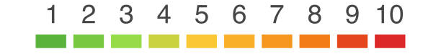

Develop a Quality Assurance framework for Image Generation Models
Problem Statement
Expectations
Context
Undertaken Tasks
Develop a comprehensive framework for conducting equitable and standardized comparisons of image generation models, ensuring 'apple-to-apple' assessments. This framework should establish consistent evaluation metrics, benchmark datasets, and evaluation protocols to facilitate a fair and meaningful comparison of various image generation techniques. The goal is to advance the field of computer vision by providing a reliable means of model assessment and selection.
Exhaustive Literature Survey of Image Generation Metrics [CLIP, FID, SFS, CHAIR & etc]
Develop a fixed framework for Quality Assurance & Identify SOTA Benchmark Levels
Statement
Currently Image Generation Models’ QA is mainly subjective in Nature, Building a Framework consisting of SOTA metrics will enable easier comparison of Image Generation Models
KPI
Framework should consider all possibilities & parameters of the Image Generation Space
Worklet Details
Pranal Prasad Dongare
+91-7022250561
pranal.p@samsung.com
2
6
Timeline
Tushar Madaan
+91-9205301569
tushar.m2@samsung.com
Kick Off < 1st Month >
Milestone 1 < 2nd Month >
Duration (Months)
Members Count
Mentors
Problem Briefing
Check Feasibility
R&D on Image Generation Metrics
Identify a framework which accurately evaluates Image Generation Models
Pre-Requisite
Familiar with Coding predominantly Python
Familiar with Diffusion Models & Evaluation Metrics
Complexity
Notes:
https://nv-tlabs.github.io/DIB-R/

Slide 3
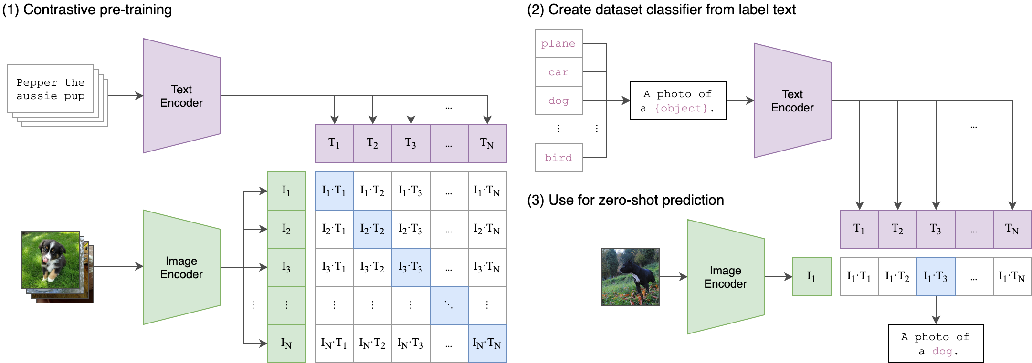
Literature survey and study
CLIP:
CLIP (Contrastive Language–Image Pre-training) builds on a large body of work on zero-shot transfer, natural language supervision, and multimodal learning, it is a neural network developed by OpenAI that can learn to connect text and images
DALL-E, a text-to-image generation model developed by OpenAI, uses CLIP to evaluate the quality of its generated images.
Reference : https://github.com/openai/CLIP

Slide 4
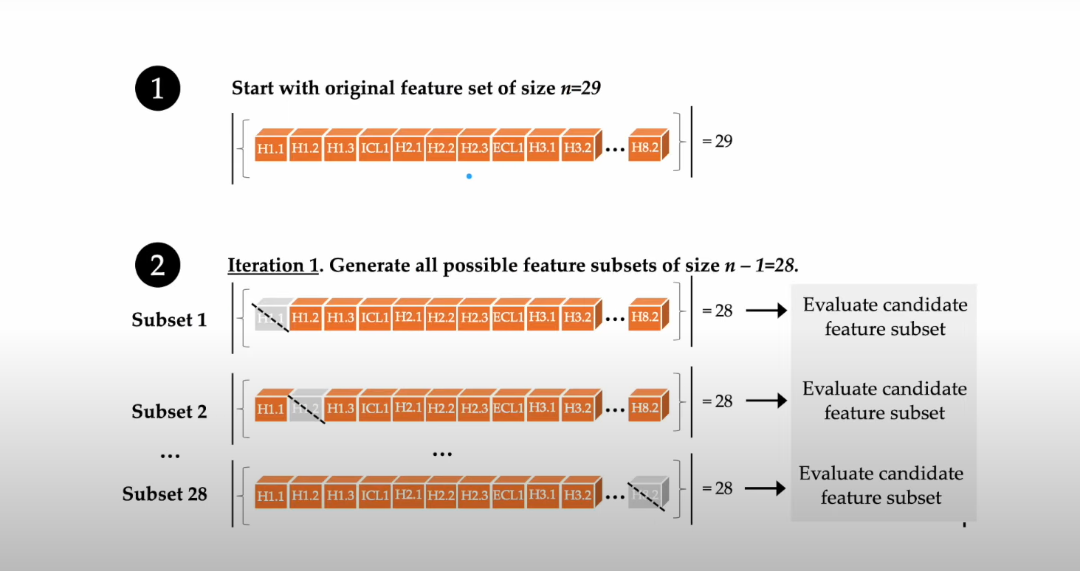

Literature survey and study
SFS (Sequential Feature Selection):
Sequential Feature Selection (SFS) is a technique for selecting a subset of features from a larger set of features to improve the performance of a model. In the context of image generation models, SFS can be applied to select relevant features or components of an image that are essential for generating high-quality images.
Trying all possible feature combinations--> Exhaustive Feature Selection

Slide 5
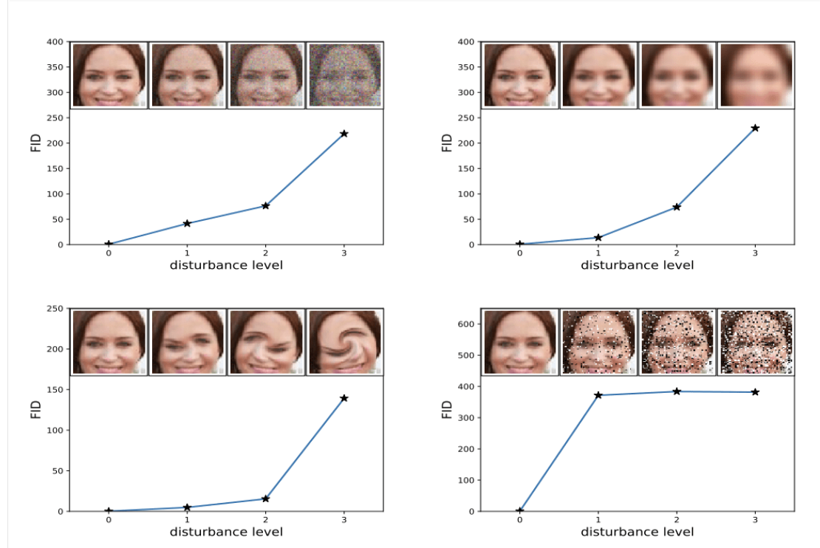
Literature survey and study
FID:
FID (Fréchet Inception Distance) captures the similarity of generated images to real ones.
Lower FID scores correlate with better-quality images when systematic distortions were applied such as the addition of random noise and blur.
the Fréchet distance d(..) between the Gaussian with mean (m, C) obtained from p(.) and the Gaussian with mean (mw, Cw)
obtained from pw(.)
FID is more consistent with different types of noise
Reference

Slide 6
Literature survey and study
Four categories of prompts varying different levels of complexity:
 | Object: | Scenery: | Shape: | Action:
 | Airplane | Summer (Can be Substituted with any season) | Triangle | Dancing
1 | An Airplane | A Summer morning on an Island | A Triangle | Two people dancing
2 | An Airplane flying in a cloudy sky | A Summer morning on an Island with the sun out | A Triangle on a table | Two people dancing on an island
3 | An Airplane flying in a cloudy sky with stormy weather | A Summer morning on an Island with the sun out and with flowers | A Red Triangle on a circular table | Two people dancing on an island full of flowers
4 | An Airplane flying in a cloudy sky with stormy weather and lightning | A Summer morning on an Island with the sun out tulip flowers | A triangle with a depth of field effect | Two people dancing on an island full of flowers near a beach
5 | An Airplane flying in a cloudy sky with stormy weather and lightning and heavy rain | A Summer morning on an Island with the sun out and with tulip and daisy flowers | A Blue Triangle on a table with a square beside it | Two people dancing on an island full of tulip flowers near a beach

Slide 7
Literature survey and study
Focusing on the following Models for image generation:
Models Obtained So far | Models to get
Stable Diffusion | Parti
MidJourney | Disco Diffusion
Dall E | VQGAN
 | BigGAN
 | StyleGAN
 | PixelCNN
 | DDPM

Slide 8
Challenges
The end objective - Do we intend to develop a model that evaluates the result of image generation model? or is it a Metric/Flowchart?
Information about "CHAIR" cannot be found, requires your specification.
Penalizing the metrics in order to perform better
Light source normalization
If possible, compare generated and real images

Slide 9
Thank you

